Slide 1
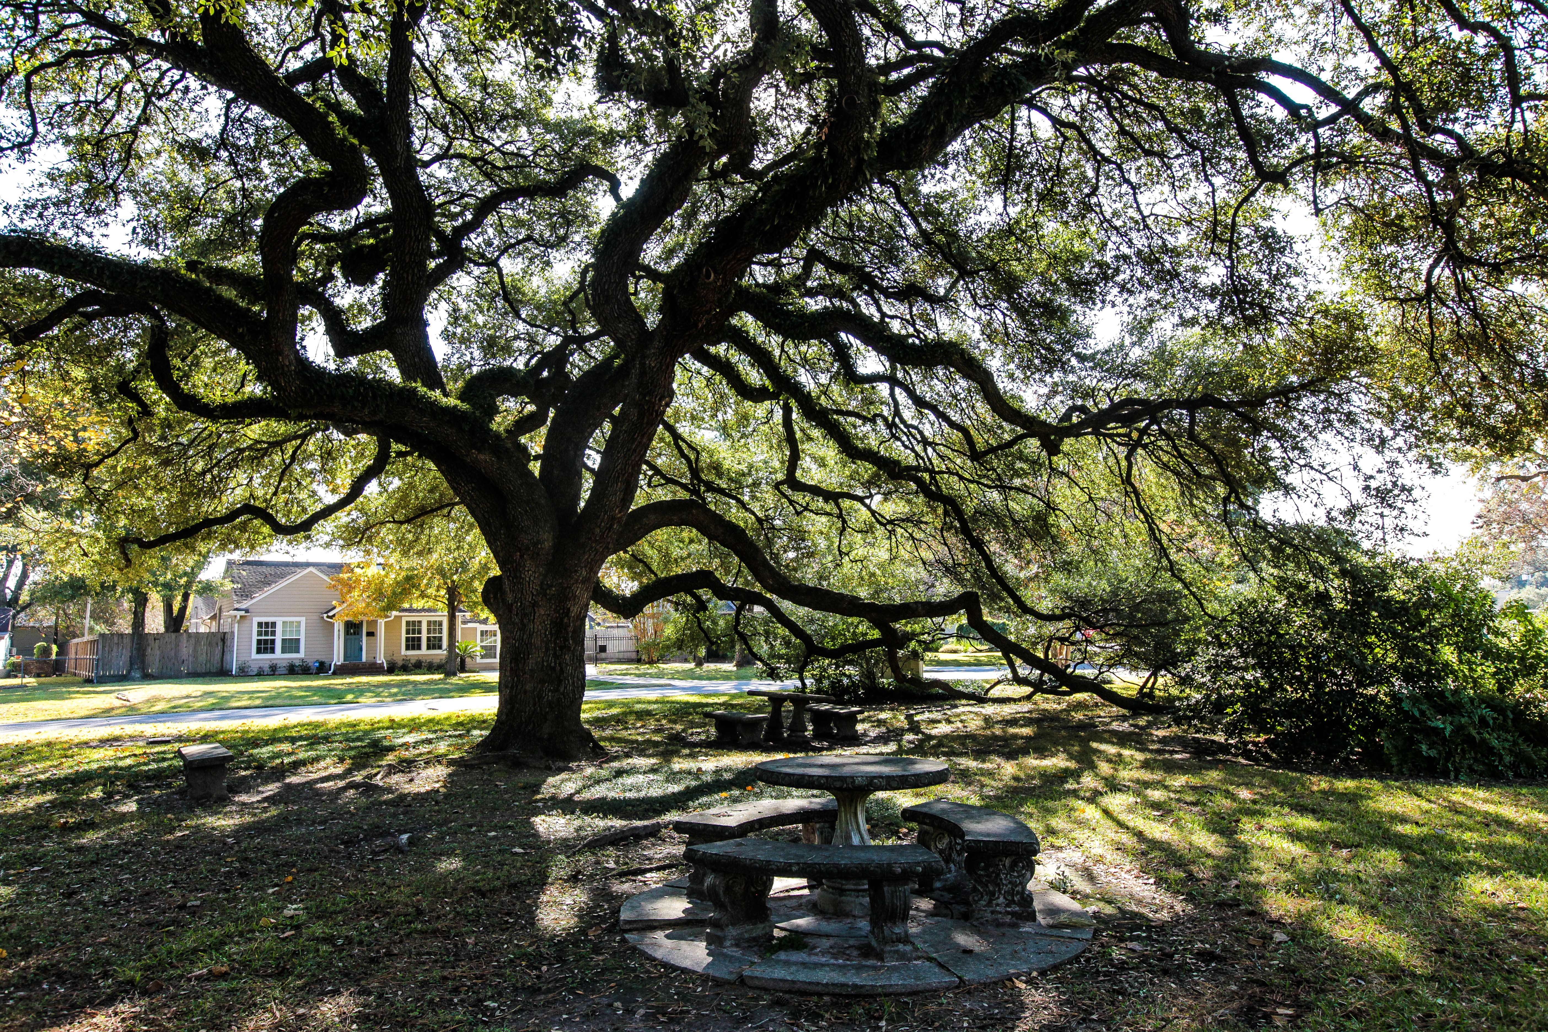
Beautification

Slide 2
It is called beautification
Attractive plantings and amenities that:
Mitigate cut through traffic and overflow parking
Provide safe play areas with comfortable seating
Enhance visual & sound buffering
While
Managing water usage
Supporting soil and wildlife health
Led by volunteers with a range of skill levels and interests.

Slide 3
Greenspace = Parks, Schools & Public ROW
Currently we:
To a much lesser extent:
Maintain 6 “adopted” ROW Pocket Parks
Mowing & Trash removal twice monthly 2.25 acres
Irrigation 600K gallons/yr
Seating/tables, swings & Gazebo
Bollards – traffic control
- water, - tree removal
+ 4 ”unadopted” ROWs
City Parks- Graham & Art
Community Garden
We don’t :
YOM
Spark Park- @ GOMM
Am. Legion & Shepherd

Slide 4
Pocket Parks
Historical Investments continue to serve the community. Plantings, Irrigation systems, seating and more.
Gazebo Park + power
Triangle
Garden Oaks Blvd.
Friendship
Rose
Berm – excluded from full adoption program
Unadopted – W 43 esplanade, Sue B slip, Durham wedge, Spark ROW

Slide 5
City Parks
None currently adopted
Graham Park - 3.56 ac
W43 & Sue Barnett (Art Park) - .80 ac
Shepherd Park – 8.19 ac
Am. Legion Park – 5.40 ac
HISD Spark Park – 2.74 ac

Slide 6
Philosophy ies
We support a range of styles
Plantings shifting to natives, lower water requirements, and pollinator friendly. Herbicides and pesticides are sparingly used.
Change is gradual with a bias against big statement new installations. Key is long term commitment to investments.

Slide 7
How we do it:
Mowing Contract
Bed Maintenance Contract is in the works
Park Captains
Fundraising
Special Projects
Adoptions
Work Days
CoH Green Space Coordinator – Marilu de La Fuente

Slide 8
Garden Oaks Blvd. Esplanade – Captain: vacant
Our largest Pocket Park at over .6 Ac.
Amenities/features
Crushed granite walkway
Protective Bollards
Switch box Mural designed by students of GOMM
3 Irrigation Controllers

Slide 9
Gazebo – Park Captain: Jenny Moreno
Ava Kirkpatrick earns 2020 Gold Award Scout
Amenities
Gazebo
Swing
2 Park Benches
Power & 7 zone irrigation system

Slide 10
Triangle – Park Captain: Tina Nieto
Tied with Berm for smallest park
Restored in 2019 after Alba Drainage Project
Native plantings
Amenities
Our best swing
3 zone Irrigation

Slide 11
Friendship – GO Garden Club
Very long term & stable management by the Garden Club
Redbuds, roses, azaleas, camelias transitioning to natives
Amenities
Tables and Benches
3 zone irrigation

Slide 12
Rose Garden – Captains: Brenda de Alba & Sheila Briones
Major overhaul in 2020
Restoration of Irrigation
Addition of drip on beds
Replanting of roses
Amenities
Mini library
Tables and Benches
Trial Rain Garden
6 zone Irrigation System

Slide 13
Berm – Captain: Sean Jez
2011
2022
Created in 2002 by closing Randall-Durham
Physical barrier to:
Cut through traffic on Randall
Sound @ Sight of Shepherd/Durham
Subject to serious motor vehicle accidents
3 zone Irrigation with water paid by GOCC

Slide 14
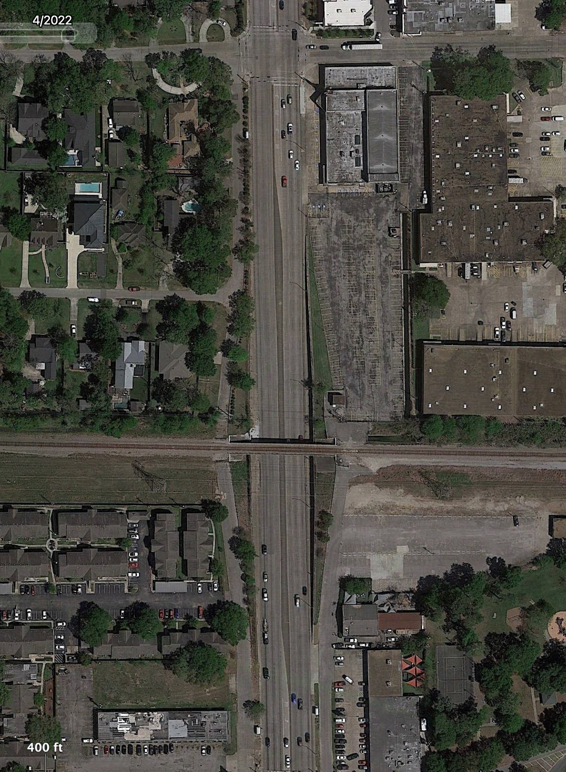
”Unadopted ROW”
Sue B Slip – ROW @ Shepherd: Sam Rezzolfi
Wedge – Durham @ W30 - Vacant
Apollo @ W 43 – Helen Sestak & Tom Cronin

Slide 15
”Unadopted” CoH Parks, Spark Park & Community Garden

Slide 16
Art Park – W43rd @ Sue Barnett
Captains: Shawn & Bill Spear with assistance from Garden Club
Brush Removal and Tree work 2019-2020
Wildflower Area 2021-2024
Amenities
Picnic Table & Trash
Raised Bed and Patio
No Water

Slide 17
Graham Park
Captain: Wayne Forster
Tree planting over 20+ years
40 trees planted in 2021
Weekly watering through draught summers
5 trees planted in 2024
Tennis Ct Improvements
Tony Padon
No Irrigation

Slide 18
Spark Park ROW
Managed by HISD ?
Street flooding is managed by leaf removal. The Cub Scouts have stepped in when HISD and or PW have failed.

Slide 19
Community Garden- GOCC as Benefactor
Representatives – Caroline Stender, Kathy Gahm, Shawn Spear
GOCC Support
Pays water
Maintains ROW
Periodic Brush Removal/Tree work
Mulch/leaf donations
Construction material donations

Slide 20
Future Projects
Contract for Pocket Park bed maintenance
Partial adoption of Art Park & Graham Park primarily to support new tree plantings
Tree Plantings Graham, Art, GO Blvd, Wedge
Recruit Park Captains
Restoration of Split Rail Fence @ Berm
Bollard replacement and gravel path maintenance Garden Oaks Blvd.
Gravel Path substitution for sidewalk Gazebo

Slide 21
Branding @ Beautification
Pillars
Entrance Signs

Slide 22
Restore & Replace Pillars
24 remain in place need cleaning & sealing, optionally painting. $75-100$ ea
12 missing concentrated along path of drainage project work on Golf & Alba may be in range of $1000 ea.

Slide 23
Entrance Signage
Originally installed in 10 locations
3 destroyed
W30th @ Durham
GO Blvd @ Shepherd
W41st @ Golf
Posts are EOL

