Slide 1
GO Civic Club Annual Survey
114 Unique Responses (approx. 8%)
74 Members (64% of survey respondents)

Slide 2
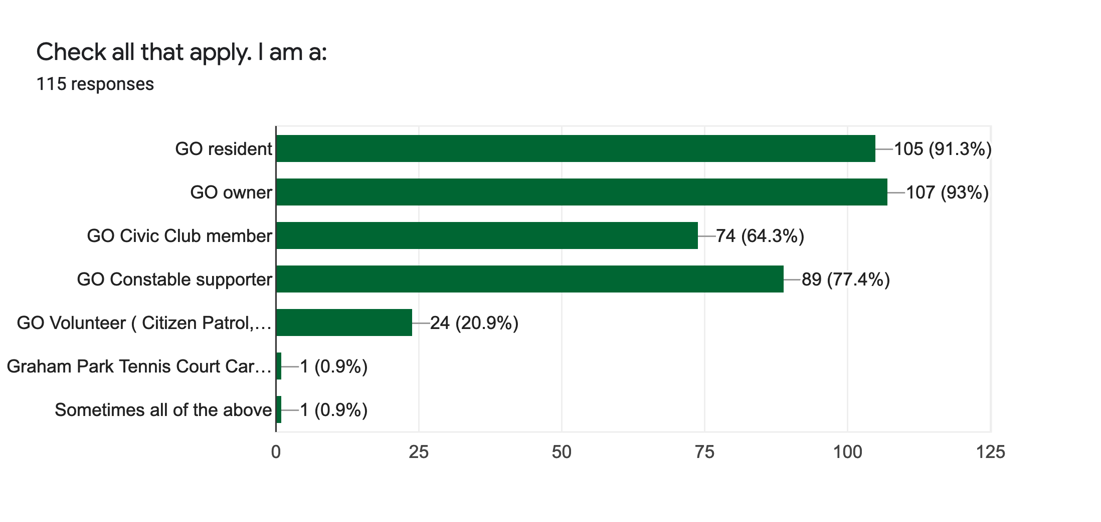
Who Participated

Slide 3
GOCC Priorities Security, Beautification, Communication
Strong Continued Support for these
Change Suggestions from Members:
Stay the same
Security, some form of deed restriction enforcement/over site, communication and beautification
Safety in neighborhood
Primary focus for 2022 should be on reaching out to more residents.
Nothing
None
No priority changes at this time.
No change required
leaving them as they are
Keep the same
I agree with the current priorities. I would pick Deed Restriction challenges carefully, fight the big battles (i.e.multifamily property use) and negotiate the settlements on the small ones (i.e. 3 car garage on 2 acre property)
Following up on the feedback of 70% of owners who want support with building plans, DR enforcement and other HOA support.
Focusing on rebuilding the sense of community.
Focus on neighborhood issues.
everything is very well run right now - kudos to GO volunteers!
continue security and communication. Try to get newer & younger folks involved. I know it has been tried with little success. No answers from me, but perhaps other have ideas.
Adding traffic control/safety for our children

Slide 4
Security- Constable and COP
Wish more participation
I appreciate the constables who patrol our area. I‚Äôm concerned about an individual who lingers at the Exxon on Yale/30th and wonder how we can help him. He appears mentally ill.
Make the $250 mandatory for all owners/residents
Need to emphasize that it is NOT connected to the HOA issues. I know that is constantly done but it does not seem to be believed.
I never see the Constables in the neighborhood anymore.
Since there are several fixed/no income/furloughed/unemployed residents can there be an option that is less than the $250?
Very happy with. They've been very helpful at a time we really needed them.
Would it be possible to do more advertising about it? Shepherd Park Plaza has signs when it's time to contribute, maybe that would help? And Oak Forest does a lot on Facebook notifying people about their Seal program. Maybe Garden Oaks does more, and I just am not aware of it.
I just wish more people would support this program. It shouldn‚Äôt be such a struggle every year.
because of our size and spread (we live in section 1) two constables is idea. would also be nice if more local business helped with donations
Must get more to donate
I have found the Constable to be responsive and present irrespective of the level of supplemental patrols
The Constable visited my home for a pre-trip evaluation. I traveled without worry.
Sorry. Retired and can't afford the extra expense until I win the lottery.
Cost should be mandatory.
Great program
Never see them on our street & neighbors agree. Glad they're at the school more often.
It completely baffles me why more residents do not contribute to this and can only assume it is because that have yet to need the constable for a security issue at there home. Really dumb on there part!
Great program - lets do more and get everyone behind this
I have never seen a constable drive down my street Section 1 32nd st. Also was not aware there is a program. If there is a program and the constable does not come to my area then we are not willing to pay. We were a part of the program in Oak Forest and saw the constable often.
I would like to have full time constable patrol. I do not see the constable provided by the single patrol very often. It would be nice to see them patrol the neighborhood more evenly.
Stop pushing fear about security. Constable only reacts doesn't prevent. So expensive and for what? Posing for pictures in gazette.
Never see the constable on a street that deserves more coverage due to two neaarby schools.
The more the merrier!!!
I don't see the benefit. Optics at best
Make mandatory

Slide 5
Beautification
Are there specific areas that you would like to see better or differently maintained? Other comments?
Section 1
Doing a great job
the median by Chase Bank on 43rd - difficult to protect from traffic but looks terrible
Graham park has so much untapped potential. would love to see the GOCC via COH update and improve the park.
I am in favor of curbs, sidewalks, and modern drainage. It is important to keep 1 house per lot restriction.
No
The garden area on N. Shepherd on the west side across from Sonic
Does the civic club own the ‚Äútriangle‚Äù parks throughout the neighborhood? Under what authority are projects abs maintenance done in these? Who pays the utilities for these areas? Section 1 triangle parks and graham park seem to be an afterthought relative to other sections of the neighborhood
Randall Berm Park needs work.
Altho city property, I would like to see the few sidewalks in section 1 maintained. Diff. to walk on sidewalks surrounding the secion
Bigger signs entering the neighborhood.
No
Do something.
Center median at 43rd and Ella by Apollo
It would be nice to have more fruit trees for kids to visit in the neighborhood. It would also be nice to have bee keeping performed in the area.
I think yall are doing a great job
signage
no
tennis courts
No
Park areas and triangles.
Again stay away from the HOA madness. Our neighborhood is fine without an HOA. Maintain a positive image for residents. HOA is only only negative.ficus on getting more people to join civic club instead. ~220 out of ~1500 homes is a terrible participation percentage.
No
The Althea/ Apollo entrance to the neighborhood
Help with getting city to do needed street maintenance.

Slide 6
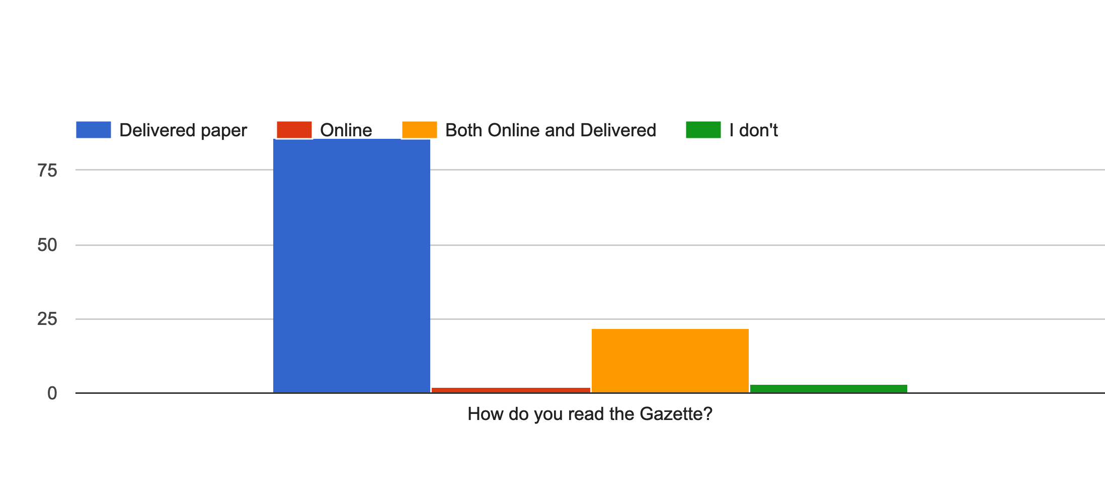
How the Gazette is Read

Slide 7
GOCC Meetings- I don’t attend because:
I moved to GO in 2013 and regularly attended for the first couple years. Sidewalks and GOMO were hot issues at the time and made for a rather unwelcoming environment, to be honest.
Too busy during the week with work and other commitments.
I have standing commitment on Tuesday and Thursday evenings
I have a conflict appointment on the first Tuesday of the month.
No interest in sitting there for an hour for 5-10 min of relevant topics
Attended sometimes but now due to our ages we don't go out much at night.
I think the GOCC and GOMO are well run and don't require my input. Taking care of two small children takes up most of my free time. I did attend a few meetings.
I have another commitment on Tuesday nights.
just lazy and anti-social
We used to attend regularly, but stopped when it got so contentious over the deed restrictions debacle. If people can't be made to be civil, I don't need to be there. I'm hoping it's changed, and will give it a try next year.
Conflict with other commitments
week nights are difficult with school aged children
I have small children and the meetings are during their dinner/bedtime.
I travel for work and normally out of town.
Attend occasionally. Often busy in evenings
Because certain members of CC were very hostile towards us.
Lost interest after the meeting where the Wine Walk was discussed and it was allowed and supported by GOCC to discriminate against a resident by no longer saying the WW was GOCC sponsored, but a private event, all to not allow a particular resident to participate. I decided that day I wanted nothing to do with the GOCC.
Will plan to attend more meetings
Single parent / times are difficult
I‚Äôve attended one meeting in the capacity of a court appointed member of the creditors committee in the Gomo bankruptcy and was appalled at the childish and disrespectful behavior of many of the civic club members who had no history with me personally - I found the organization to demonstrate an unwelcoming, prejudiced and sophomoric culture
I am not interested in attending right now.
I am Zoomed out
Too busy, forget to put it on the calendar
Don't remember that it is happening. Also have had standing Tuesday evening commitments in the past.
I am not "a meeting type" person
Not sure a lot gets done. Wld rather receive emails
I usually forget to log in via Zoom
No driving after dark.
We moved here shortly before the pandemic, so I haven‚Äôt attended.
Always get the Gazette too late to plan attendance.
Work, illness
I'm often engaged in other activities.
Work 12 hour/ day, tired
Same folks from the failed organization overpowering meetings. Not much interest in fixing what‚Äôs broken.
I usually have a conflict or don‚Äôt want to pay for babysitting
Busy with kids & work
I can't stand bickering and controversy.
I have not attended recently due to time/medical issues but would like to get back to it in the future.
speakers weren't interesting - I'm not interested in school related issues
I don't like zoom meetings.
need the kids to be older. I'll trust my senior members for now
I periodically attend
Schedule and kids
I do when something matters
When I used to attend, many of the other attendees acted immature to each other
When we first moved here, we had a conflict with the GOCC meeting day/time and therefore couldn't attend. We never got into the habit.
Busy with weekly events.
After the mess with the HOA situation, I lost interest in participation of neighborhood goings on.
I am often busy at the time the meetings are held
Scheduling conflict on Tue PMs
I don't attend because the board / officers are very exclusionary. In other words they have their clic and they think they know what's best for everyone else and everything. They are rude and condescending. Same group of folks that ran GOMO into the ground. They are not humble. After 15 years move along do let others volunteer for positions. Stop being control freaks. Same faces doing the same jobs every year.
Tonya has done a good job in bringing relevant topics to the meetings. I know she was working on keeping committee reports to a time limit which was needed. We hope to attend meetings that are of interest to us in the future.
Conflicts with work/late evening work events/work travel
I was often out of town. Now that I am retired I hope to attend more frequently
I am way too busy with full time lawyering and three children under 7.
I‚Äôm surprised at my recent poor GOCC attendance. Part of it was recovering from effort related to the GOMO bankruptcy but that is already some time ago. I participate in many ZOOM mtgs and am comfortable w that format and appreciate its convenience/efficiency. However, my participation in GOCC isn‚Äôt necessarily based on ‚Äúneed‚Äù but likely more on ‚Äúwanting‚Äù to go. I wonder if lack of in person mtgs and lack of putting out the yard signs publicizing the meetings put GOCC out of my mind.
In past, It has always been scheduled on night that I have different meeting
Usually busy with my young kids bedtimes at the time it happens.
Life is hectic. I don't see any major issues other than 41st Street falling apart and the city doing nothing about it
Weeknights are hard with kids

Slide 8
GOCC Meetings- Increase attendance by:
Welcome new neighbors.
More virtual meetings.
make it Wednesdays
I liked the zoom option but probably not viable going forward
also offer video attendance option
I think they already do a good job by providing pizza and having the raffle. Also, some of the guests are interesting. So I'm not sure there is any more they could do.
Didn‚Äôt favor the zoom meetings, yet I understand why we had to do it. I like trying to make monthly meeting or at least quarterly.
Yes, by not associating itself with any DR activities. It will take years for CC to rebuild trust and increase in participation due to CC being the collateral damage of GOMO‚Äôs gross mismanagement of neighbors‚Äô money and goodwill
I don't think so- I'm not harboring resentment, I'm not angry. I am just trying to limit my involvement with groups who act like that. Happy to continue helping with the deed restriction clause removal, though.
Respect your neighbors
No, are Zoom meeting recorded? Would be interested in watching recorded meetings at a time more convenient for me.
Possibly more likely to attend in person, depending on my schedule and availability
Attending online would greatly increase my chance of attending due to my schedule.
Send out calendar invites to member's emails, then I could set a reminder much more easily.
Distribute the Gazette a little further in advance so that I can remember and plan to attend. It has arrived day after or day of meeting.
A little more advance notification...perhaps email sent before the Gazette delivery.
I have volunteered a few times before and no one got back to me. Response would be nice.you may be using an email address I do not use.
No
Too little time
No
Come together as a fresh organization to make Garden Oaks better.
Zoom reminder
Offer online attendance (Zoom, WebEx, etc)
I always forget - maybe send a reminder
As much as I'd like to attend, I just don't have much free time right now.
Stream live via zoom
no
Get vaxed and boosted, put on a mask and call a meeting!
No
I think the plan to send out emails re: topic and meeting location is a good one. No one asked, but: I think our social media marketing is totally worthless and pretty much non existent. I also think getting an updated database is more important than new logos.
It would be nice to have a post settlement meeting to update everyone and discuss how things will go moving forward.
Maintaining a zoom option is a really good way to engage young families that want to be involved but might have conflicts with dinner, homework, and bedtimes.
Money
Make folks who are willing to help feel more welcome.
Not unless you could magically make my children older!
Return of yard signs announcing the upcoming meeting
Alternate meeting dates- example first Tuesday of month odd number months and first Thursday of month On even months. Or something similar
I have attended a couple of meetings. E-mail reminders would be helpful.
I will try to attend the zoom meeting tomorrow, it kid activities usually preclude me from making them.

Slide 9
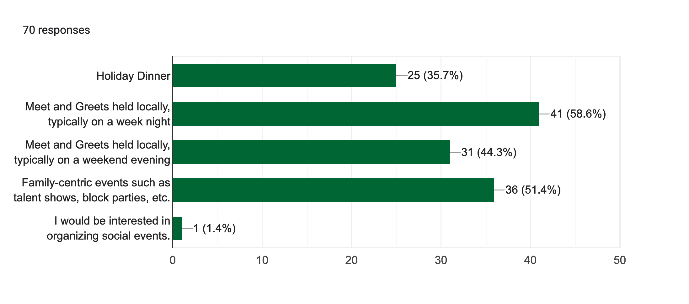
Interest in Social Activities

Slide 10
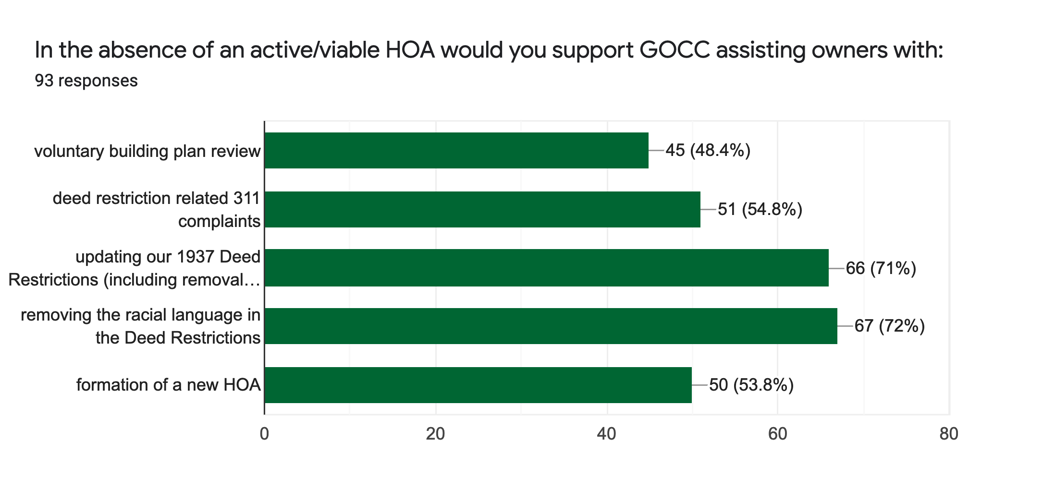
Support for DR Related Activity

Slide 11
“YES” to NEW volunteer or donor 32 (58 if DR included)

